Slide 1
Understanding the Three Child Outcomes
Maryland State Department of Education - Division of Special Education/Early Intervention Services
Notes:
Welcome to the Session 1 presentation, “Understanding the Three Child Outcomes.” In this presentation, we talk about why it is necessary to collect outcomes data. Then we describe the three child outcomes, where they came from, and how we define each one.

Slide 2
Goal of Early Intervention & Preschool Special Education
“…To enable young children to be active and successful participants during the early childhood years and in the future in a variety of settings – in their homes with their families, in child care, in preschool or school programs, and in the community.”
Family and Child Outcomes for Early Intervention and Early Childhood Special Education, Early Childhood Outcomes Center. (April 2005). Available at: http://www.fpg.unc.edu/~eco/assets/pdfs/eco_outcomes_4-13-05.pdf
Maryland State Department of Education - Division of Special Education/Early Intervention Services
Notes:
Let’s begin with the overarching goal of early intervention and preschool special education, developed through an extensive stakeholder process conducted by the Early Childhood Outcomes Center in 2004, when the outcome requirements were just being defined. Stakeholders involved in the process included families, providers, teachers, local, state and federal administrators, and researchers. The goal of both programs is “… to enable young children to be active and successful participants during the early childhood years and in the future in a variety of settings—in their homes, with their families, in child care, in preschool programs, and in the community.” As you can see, stakeholders developed a goal that is based on a vision for what ALL families would want for their children. The three child outcomes later were based on this overarching goal.

Slide 3
Public Policy Context
Age of accountability
Accountability means both compliance and results
U. S. Office of Special Education Programs (OSEP) funded the Early Childhood Outcomes Center to develop measures to show effectiveness of early intervention and preschool special education programs
Maryland State Department of Education - Division of Special Education/Early Intervention Services
Notes:
When we look at the big picture, it’s clear that we live in an age of accountability. Accountability means that we must look at how we provide services, and the results of those services. In other words, we are not just interested in how many children participate in early intervention and preschool special education services, but also in how young children with disabilities are benefiting from these services. IDEA 2004 introduced this focus on results, and the U. S. Office of Special Education Programs, or OSEP, was now required to show Congress that children who participate in the IDEA Part C Early Intervention Program and the Part B Preschool Special Education Program are indeed making progress. OSEP funded the Early Childhood Outcomes Center to assist in the development of measures to show the effectiveness of these programs. The Early Childhood Outcomes Center pulled together stakeholders, including families, providers, teachers, administrators, and researchers, to build consensus around outcomes measurement for young children with disabilities, birth through five, and their families. This approach was and continues to be in alignment with Maryland’s approach to implementing a birth through five seamless and comprehensive system of coordinated services within the larger framework of a birth through 21 service delivery system. This system is designed to ensure that all students are ready for school, achieve in school, and are prepared for college, careers, community, and life.

Slide 4
Child Outcomes Measurement, As Required by the Office of Special Education Programs (OSEP)
Children have positive social-emotional skills (including social relationships)
Children acquire and use knowledge and skills (including early language/communication and early literacy)
Children use appropriate behaviors to meet their needs
Maryland State Department of Education - Division of Special Education/Early Intervention Services
Notes:
To measure the outcomes of children in early intervention and preschool special education services, stakeholders strongly recommended the use of a single, unified set of functional outcome statements for children with disabilities, birth through 5. They also recommended that the language of the outcomes statements be universal, and that the outcomes be functional rather than domains based.
So beginning in 2005, the U. S Office of Special Education Programs required states to measure and report on the extent to which children make progress in three areas:
Outcome 1: Children have positive social-emotional skills (including social relationships)
Outcome 2: Children acquire and use knowledge and skills (including early language/communication and early literacy for preschoolers), and
Outcome 3: Children use appropriate behaviors to meet their needs

Slide 5
OSEP Reporting Categories for Each Outcome
Percentage of children who:
a. Did not improve functioning
b. Improved functioning, but not sufficient to move nearer to functioning comparable to same-aged peers
c. Improved functioning to a level nearer to same-aged peers but did not reach it
d. Improved functioning to reach a level comparable to same-aged peers
e. Maintained functioning at a level comparable to same-aged peers
Maryland State Department of Education - Division of Special Education/Early Intervention Services
Notes:
For each of the three outcomes, there are five progress categories in which states report their annual performance data. States report, in category a, the percentage of children who did not improve functioning; in category b, the percentage of children who improved functioning, but not sufficient to move nearer to functioning comparable to same-aged peers; in category c, the percentage of children who improved functioning to a level nearer to same-aged peers but did not reach it; in category d, the percentage of children who improved functioning to reach a level comparable to same-aged peers. And finally, in category e, the percentage of children who maintained functioning at a level comparable to same-aged peers.
Reporting progress in five different categories acknowledges that children make varying amounts of progress.

Slide 6
OSEP Summary Statements
Summary Statement 1:
Of those children who entered the program below age expectations in each Outcome, the percent who substantially increased their rate of growth by the time they exited the program
Summary Statement 2:
The percent of children who were functioning within age expectations in each Outcome by the time they exited the program
Maryland State Department of Education - Division of Special Education/Early Intervention Services
Notes:
States are then asked to summarize the data from the reporting categories into two statements. For summary statement 1 states report, of those children who entered the program below age expectations in each Outcome, the percent of children who substantially increased the rate of growth by the time they exited the program. In summary statement 2, states report the percent of children who were functioning within age expectations in each Outcome by the time they exited the program. Specific calculations are used to summarize these data.

Slide 7
Big Picture: Outcomes, Progress, and Summary
A. Positive social-emotional skills (including social relationships)
B. Acquisition and use of knowledge and skills (including early language /communication and early literacy)
C. Use of appropriate behavior to meet needs
(a)
Percent of preschool children who did not improve functioning
(% children above / # of preschool children with IEPs assessed) x 100
(b)
Percent of preschool children who improved functioning but not sufficient to move nearer to functioning comparable to same-aged peers
(% children above/ # of preschool children with IEPs assessed) x 100
(c)
Percent of preschool children who improved functioning to a level nearer to same-aged peers but did not reach it
(% children above / # of preschool children with IEPs assessed) x 100
(d)
Percent of preschool children who improved functioning to reach a level comparable to same-aged peers
(% children above / # of preschool children with IEPs assessed) x 100
(e)
Percent of preschool children who maintained functioning at a level comparable to same-aged peers
(% children above / # of preschool children with IEPs assessed) x 100
Summary Statement 1
Of those children who entered the preschool program below age expectations in each Outcome, the percent who substantially increased their rate of growth by the time they entered kindergarten or exited the program.
% = # of children reported in (c) plus # of children reported in (d) / [# of children reported in (a) plus # of children reported in (b) plus # of children reported in (c) plus # children reported in (d)] x 100
Summary Statement 2
The percent pf preschool children who were functioning within age expectations in each Outcome by the time they entered kindergarten or exited the program.
% = # of children reported in (d) plus # of children reported in (e) / [the total # of children reported in (a) + (b) + (c) + (d)+ (e)] x 100
Maryland State Department of Education - Division of Special Education/Early Intervention Services
Notes:
Here you can see the big picture. Along the top in red boxes are the three child outcomes. The boxes in blue below describe the progress data states must collect for each of the three child outcomes. The progress data are then used to summarize children’s results while in and upon exiting both early intervention and preschool special education, as seen in the yellow boxes at the bottom.

Slide 8
Why Collect Child Outcomes Data?
In gathering child outcomes data, programs are able to
Inform stakeholders, including families, about the effectiveness of the program
Identify program strengths and weakness for improving program services and delivery
Provide information for policymakers to justify future funding of programs
Meet the Office of Special Education Program (OSEP) reporting requirements
Maryland State Department of Education - Division of Special Education/Early Intervention Services
Notes:
So why do we collect these data? When child outcomes data are aggregated across children, they can tell us whether a program is improving outcomes for the children it serves. We can also use these data to inform the development of program improvement activities: Part C and Part B preschool program leaders can use the information to determine not only state program effectiveness, but also priorities for training and technical assistance in regional and local programs.
When we consider all of these uses, it becomes clear that child outcomes data can be used for multiple purposes beyond reporting information to the federal government as required. Gathering child outcomes data is valuable on multiple levels and for all involved, with a shared goal of promoting positive outcomes in children.

Slide 9
The Three Child Outcomes
Children have positive social-emotional skills (including social relationships)
Children acquire and use of knowledge and skills (including early language/communication and early literacy)
Children use appropriate behaviors to meet their needs
Maryland State Department of Education - Division of Special Education/Early Intervention Services
Notes:
Let’s return for a moment to the three child outcomes. Note that they are not skill- or domain-based.

Slide 10
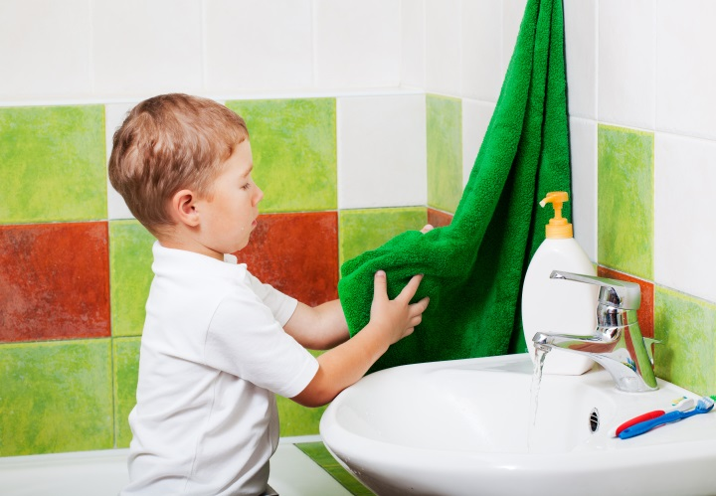
Child Outcomes Are Functional
Functional outcomes refer to
Things that are meaningful to the child in the context of everyday living
An integrated series of behaviors or skills that allow the child to achieve the important everyday goals
Maryland State Department of Education - Division of Special Education/Early Intervention Services
Notes:
Collectively, the three child outcomes are meant to look at a child’s everyday functioning rather than how he or she performs on a specific item on an assessment measure. For example, we’re not looking at how a child places a ring on the stacking toy. Rather, can the child find the loop on her coat to hang it on the hook in her cubby? For a younger a child, we’re not just interested in whether or not the child can smile, we want to know whether the child smiles back at mom in interactive social play. The focus is on the child’s ability to take functionally meaningful actions.

Slide 11
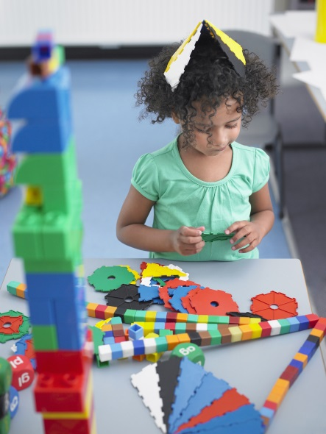
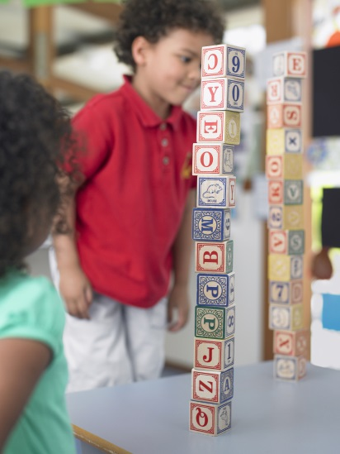
Outcomes Reflect Global Functioning
Each outcome is a snapshot of:
The whole child
Status of the child’s current functioning
Functioning across settings and situations
Rather than:
Skill by skill
In one standardized way
Split by domains
Maryland State Department of Education - Division of Special Education/Early Intervention Services
Notes:
Another way to think about the child outcomes is that they reflect children’s GLOBAL functioning. The three outcomes are broad. They are meant to give a snapshot of the whole child in his or her everyday life. For this reason, the outcomes cross developmental domains in order to see how children integrate skills and behaviors to participate in their everyday activities.
This means we’ll be asking more functional questions about a child.
For outcome 1, we might ask questions like -- How does the child show affection? And, How does the child interact with others?
We might ask questions about how the child problem solves or how the child shows that he or she understands concepts or words to learn about the child’s functioning in outcome 2.
And for outcome 3, we might ask: How does the child indicate hunger?
Let’s say we observe a child who uses 3-word phrases to engage another child in play during center time. This tells us about how the child integrates language with social functioning. We want to know more than the number of words in the child’s vocabulary, we want to know how she puts words and actions together in meaningful, functional ways.

Slide 12
Outcome 1: Children Have Positive Social Relationships
This outcome involves:
Relating with adults
Relating with other children
For older children, following rules related to groups or interacting with others
Includes areas like:
Attachment/separation/autonomy
Expressing emotions and feelings
Learning rules and expectations
Social interactions and play
Early Childhood Outcomes Center (2009, November). The child outcomes. Available from http://ectacenter.org/eco/assets/pdfs/Child_Outcomes_handout.pdf
Maryland State Department of Education - Division of Special Education/Early Intervention Services
Notes:
Let’s take a closer look at each outcome area, beginning with Outcome 1: Children have positive social relationships. This includes relationships with adults and other children and getting along in groups for older children. Assessment tool items and observations often include looking at: attachment/separation/autonomy, expressing emotions and feelings, learning rules and expectations, and social interactions and play.

Slide 13
Outcome 2: Children Acquire and Use Knowledge and Skills
This outcome involves:
Thinking and reasoning
Remembering
Problem solving
Using symbols and language
Understanding physical and social worlds
This outcome includes:
Early concepts—symbols, pictures, numbers, classification, spatial relationships
Imitation
Object permanence
Expressive language and communication
Early literacy
Early Childhood Outcomes Center (2009, November). The child outcomes. Available from http://ectacenter.org/eco/assets/pdfs/Child_Outcomes_handout.pdf
Maryland State Department of Education - Division of Special Education/Early Intervention Services
Notes:
Outcome 2 states that children acquire and use knowledge and skills. This involves thinking, reasoning, remembering, problem solving, using symbols and language and understanding physical and social worlds – such as science and social studies. Assessment and observation often include looking at early concepts, expressive language and communication, and, for older children, early literacy, and numeracy.

Slide 14
Outcome 3: Children Take Appropriate Action to Meet Needs
This outcome involves:
Taking care of basic needs
Getting from place to place
Using tools (e.g., fork, toothbrush, crayon)
In older children, contributing to their own health and safety
This outcome includes:
Integrating motor skills to complete tasks
Self-help skills (e.g., dressing, feeding, grooming, toileting, household responsibility)
Acting on the world to get what one wants
Early Childhood Outcomes Center (2009, November). The child outcomes. Available from http://ectacenter.org/eco/assets/pdfs/Child_Outcomes_handout.pdf
Maryland State Department of Education - Division of Special Education/Early Intervention Services
Notes:
Outcome 3 states that children take appropriate action to meet their needs. This includes basic self help and adaptive skills such as taking care of basic needs, getting from place to place, using tools and contributing to their own health and safety. Skills and behaviors might include integrating motor skills to complete tasks, self-help skills and acting in appropriate ways to get what one’s needs or wants met.

Slide 15
Child Outcomes Make a Difference
Early intervention and preschool special education strives to achieve all three of the outcomes for all children receiving services
Gathering child outcomes data is an important part of the process to show areas for program improvement that can help participants
Maryland State Department of Education - Division of Special Education/Early Intervention Services
Notes:
In summary, child outcomes data help us know if early intervention and preschool special education are making a difference for the children these programs serve. Gathering child outcomes data also helps us determine how to improve programs to make more of a difference in the lives of these children. Outcomes data help us identify what works and what might work even better. The information gathered provides useful context to professionals and families at all levels for better decision-making and program planning. That’s why child outcomes data matters.

Slide 16
Questions?
Nancy Vorobey
Section Chief, Prevention Initiatives and Early Childhood
410-767-0234
nancy.vorobey@maryland.gov
Pam Miller
Quality Assurance Specialist
410-767-1019
pamela.miller@maryland.gov
Notes:
We have reached the conclusion of this presentation. We thank you for taking the time to complete the Session 1 presentation, “Understanding the Three Child Outcomes”. Should you have questions about the Maryland Preschool Child Outcomes Summary (COS) Process, please contact the individuals listed here.

