Slide 1
An Overview of the
Child Outcomes Summary
Rating Process
Maryland State Department of Education - Division of Special Education/Early Intervention Services
Notes:
Welcome to the Session 3 presentation, “An Overview of the Child Outcomes Summary Rating Process”. In this presentation we introduce the Child Outcomes Summary Rating Process, discuss its purpose and its theoretical framework, and talk about how teams document and arrive at a rating for a child.

Slide 2

Teaming in the Child Outcomes Summary Process
Consensus building process
Team members
  The child’s IFSP or IEP team, including family members
  People with essential knowledge about the child
Maryland State Department of Education - Division of Special Education/Early Intervention Services
Notes:
The Child Outcomes Summary, or COS process is designed to be a team consensus process. In Maryland, the team is the IFSP or IEP team. Teams should always include a member of the child’s family. Family members know the child best and can provide information about the child’s functioning, and cultural expectations for functioning, in everyday routines and activities. The COS process provides a way to support the family’s role as active partners in decision-making for their child.

Slide 3
Family Partnerships in the COS Process
Families need to know what to expect:
  What do the outcomes mean?
  Why and how are the outcomes being measured?
Engage and include family members in the COS process
  They can help the team arrive at an appropriate child outcomes rating
  They may not always know whether their child is showing age appropriate behavior
  They know their child best across setting and situations
Maryland State Department of Education - Division of Special Education/Early Intervention Services
Notes:
It’s essential that families know what the outcomes mean for them and their children. Being able to share with families why we have outcomes, why they are needed, and how they will be measured will be important.
Taking time to engage and include families in all aspects of the COS process will be valuable in securing their support and in arriving at a rating that accurately reflects the child’s global functioning at a single point in time and across settings. They may not always know whether their child is showing skills and behaviors expected of the same age, however they do know their child best and should be involved in all decisions regarding their child.

Slide 4
Essential Teaming Skills for Completing the
COS Process
Between them, team members must be able to:
Understand the content of the three child outcomes
Be aware of the child’s functioning in his or her natural environments
Gather and document functional information about a child via assessment
Understand age-expected child development and cultural expectations for development
Know how to use the 7-point rating scale
Arrive at a rating, through consensus with team members, about the child’s global functioning in each of the three outcomes
Maryland State Department of Education - Division of Special Education/Early Intervention Services
Notes:
Let’s review the essential skills team members need to complete the COS process.
To be able to participate in the COS process, team members must have a strong understanding of the three child outcomes and the behaviors and skills that align with each one. Team members must also know about the child’s functioning in various natural environments such as the home, with a baby sitter, in child care or preschool or in the family’s neighborhood. To capture the child’s global functioning at a single point in time, members of the team should be able to gather and document information via multiple methods and sources (meaning through the assessment process). An understanding of development will help team members determine whether the child is using skills and behaviors expected for children his or her age. Since development can be influenced by family culture, someone on the team should also have an understanding of cultural variations for development. For example, cultures may vary in their emphasis of independence and may encourage self-feeding or dressing at earlier ages than other cultures. Including family members on the team, as mentioned earlier, further helps in understanding these expectations.
The team also needs to be familiar with the 7-point rating scale and how to use it. Understanding the differences among the seven points will be critical in arriving at a rating in each outcome area. We will focus on these two latter areas, or numbers 5 and 6, in this session.

Slide 5
What is the COS Rating Scale?
It is not an assessment tool
It uses information from assessment tools and observations to get a global sense of how the child is doing at one point in time
Opportunity to reduce rich information from assessment and observation into ratings to summarize the child’s progress
Maryland State Department of Education - Division of Special Education/Early Intervention Services
Notes:
The child outcomes rating scale is not an assessment tool. It’s a way of summarizing information from various data sources including results from assessment tools, parent input and observation. The rating is meant to reflect a GLOBAL sense of the child’s functioning. The summary form is completed at two points in time, when the child enters the program and when the child exits the program. Additionally, in Maryland, teams will be completing COS ratings annually at IEP reviews.

Slide 6

Features of the COS Rating Scale
Rating is based on the child’s functioning:
What the child does across settings and situations
Compared with what is expected given the child’s age
Maryland State Department of Education - Division of Special Education/Early Intervention Services
Notes:
The 7-point COS rating scale is a mechanism to summarize assessment data to describe the child’s global functioning, in comparison to what is expected for children of the same age, in each of the three outcome areas.
Documenting children’s movement toward age-appropriate functioning is one type of evidence that can be used to make a case for the effectiveness of early intervention and preschool special education. This is why the 7-point scale was developed—to provide a mechanism for documenting that evidence.

Slide 7
The Two Questions to Guide the COS Process
To what extent does this child show age-appropriate functioning, across a variety of settings and situations, on this outcome?
  Rating: 1-7
  Entry, annually, and exit
Has the child shown any new skills or behaviors related to [this outcome] since the last outcomes summary?
  Progress: Yes/No
  Annually and exit
Maryland State Department of Education - Division of Special Education/Early Intervention Services
Notes:
We use the ratings to answer two questions:
First. to what extent does this child show age-appropriate functioning across a variety of settings and situations on this outcome? Team members with essential knowledge of the COS process including, assessment and age-expectations will be able to answer this question both at the child’s entry into and exit out of early intervention or preschool special education. Remember, teams in Maryland will also be required to rate child progress at the annual IEP.
The second question, Has the child shown ANY new skills or behaviors related to this outcome since the last outcomes summary?, asks the team to determine whether the child made progress since the last outcomes summary rating. So the team will answer this question annually, and at exit.
Both questions will need to be completed for each of the three outcomes.

Slide 8
The 7-Point COS Rating Scale
For each outcome, rate the child’s global functioning:
7: Completely age-expected
6: Between “completely” and “somewhat”
5: Somewhat age-expected
4: Between “somewhat” and “nearly”
3: Nearly age-expected
2: Between “nearly” and “not yet”
1: Not yet age-expected
Maryland State Department of Education - Division of Special Education/Early Intervention Services
Notes:
Let’s take a closer look at the rating scale which helps us answer the first question: To what extent does this child show age-appropriate functioning, across a variety of settings and situations, on this outcome?
Higher ratings on the scale indicate age appropriate functioning based on age expectations, while lower numbers indicate distance from age appropriate functioning.
Keep in mind that a rating does not reflect the child’s performance on one assessment, rather the rating provides an opportunity for the team to summarize the child’s progress across multiple assessments and observations at a single point in time.
Let’s take a moment to review each rating.

Slide 9
7 – Completely
The child shows behaviors and skills expected in all or almost all everyday situations that are part of the child’s life (e.g., home, store, park, child care, with strangers)
The child’s functioning is considered appropriate for his/her age
No one has significant concerns about the child’s functioning in this outcome area
Maryland State Department of Education - Division of Special Education/Early Intervention Services
Notes:
A child’s functioning is rated at level 7 if his skills and behaviors are age-appropriate across situations and settings and no one has significant concerns about his functioning in the outcome area.

Slide 10
6 – Between Completely and Somewhat
The child’s functioning generally is considered appropriate for his or her age, but there are some significant concerns about the child’s functioning in this outcome area
Although age-appropriate, the child’s functioning may border on not keeping pace with age expectations
Maryland State Department of Education - Division of Special Education/Early Intervention Services
Notes:
A child’s functioning would be rated level 6 if she is overall age-appropriate, but there are concerns about her development in the outcome area. You would use a rating of 6 if the child is functioning at age level now, but shows early signs of developmental problems.

Slide 11
5 – Somewhat
The child shows functioning expected for his/her age some of the time and/or in some situations
The child’s functioning is a mix of age-appropriate and not appropriate functioning
The child’s functioning might be described as like that of a slightly younger child
Maryland State Department of Education - Division of Special Education/Early Intervention Services
Notes:
Consider a rating of 5 for a child who is showing age-appropriate skills and behaviors in some situations but not others. There is a mix of appropriate and not appropriate skills and behaviors. The child’s functioning might be described as like that of a slightly younger child.
We use the terminology that behaviors MIGHT BE more like those of younger children intentionally. For example, some children may demonstrate behaviors that are not age appropriate nor are they like those of a young child – for example, self-injury is not a behavior you would expect at any age.

Slide 12
4 – Between a 5 and a 3
Child shows some age appropriate functioning some of the time or in some situations or settings but most of the child’s functioning would be described as not yet age appropriate
The child’s functioning might be described as like that of a younger child
Maryland State Department of Education - Division of Special Education/Early Intervention Services
Notes:
A rating of 4 would be appropriate for a child that rarely uses age-appropriate skills. With a rating of 4, there is much more behavior that is NOT age-appropriate than appropriate.

Slide 13
3 – Emerging
The child does not yet show functioning expected of a child his/her age in any situation
The child’s behaviors and skills include immediate foundational skills on which to build age-appropriate functioning
The child’s functioning might be described as like that of a younger child
Maryland State Department of Education - Division of Special Education/Early Intervention Services
Notes:
We would use a rating of 3 for a child who uses immediate foundational skills across situations and settings. The child is not using any age appropriate skills. With a rating of 3, the child’s functioning might be described as like that of a younger child. In a moment, we will talk about what we mean by immediate foundational skills.

Slide 14
2 – Between 3 and 1
The child does not yet show functioning expected of a child his/her age in any situation
The child’s behaviors and skills does have some of the immediate foundational skills on which to build age-appropriate functioning but these are not displayed very often
The child’s functioning might be described as like that of a younger or even much younger child
Maryland State Department of Education - Division of Special Education/Early Intervention Services
Notes:
Consider a rating of 2 for a child who uses some immediate foundational skills across situations and settings, but not very often.

Slide 15
1 – Not Yet
The child does not yet show functioning expected of a child his/her age in any situation
The child’s skills and behaviors also do not yet include any immediate foundational skills on which to build age-appropriate functioning
The child’s functioning might be described as like that of a much younger child
Children with 1 ratings still have skills, just not yet at an immediate foundational level
Maryland State Department of Education - Division of Special Education/Early Intervention Services
Notes:
And finally, consider a rating of 1 for a child who is not yet using age-appropriate NOR immediate foundational skills. The child’s functioning might be described as like that of a much younger child. Note that children with a rating of 1 still have skills, but they are not at that immediate foundational level. For example, you would expect a child of 3 to use 3-word phrases. Use of two-word phrases could be considered an immediate foundational skill. However, use of single words for a three year old would NOT be considered an immediate foundational skill. (Remember, in determining a rating, the use of words is just one piece of evidence to be considered.)

Slide 16
What Are Immediate Foundational Skills?
Foundational skills are…
  Skills and behaviors that occur earlier in development and serve as the foundation for later skill development
  Teachers and interventionists often use foundational skills to help children move to the next level developmentally
Immediate foundational skills are…
  Skills that are conceptually linked to later skills and immediately precede the later skills developmentally
  Example: Children play alongside one another before they interact in play
Maryland State Department of Education - Division of Special Education/Early Intervention Services
Notes:
Let’s return to immediate foundational skills for a moment. It’s important to understand this concept to differentiate among the lower rating categories on the scale. Foundational skills are those that occur earlier than and serve as the foundation for later skill development. Teachers and interventionists often use foundational skills to help children move to the next level of development. Immediate foundational skills are those that immediately precede age-appropriate skills on a developmental continuum. For example, children play along side one another before they interact in play.

Slide 17

Immediate Foundational Skills Example
Devon is 4 year old (48 mo.) child. During meal time at school he pours milk from a pitcher into his own cup, but needs regular verbal reminders of when to stop pouring so he does not overfill his cup. Without the reminders he would overfill his cup and spill the milk.
Maryland State Department of Education - Division of Special Education/Early Intervention Services
Notes:
Let’s look at another example of immediate foundational skills:
Devon is a 4 year old (48 mo.) child. During meal time at school he pours milk from a pitcher into his own cup, but needs regular verbal reminders of when to stop pouring so he does not overfill his cup. Without the reminders he would overfill his cup and spill the milk.
Here, Devon is showing us immediate foundational skills for outcome 3, taking appropriate action to get his needs met.
Developmentally, we would expect 4-year olds to be able to pour themselves a drink during mealtime. This will depend on the child’s understanding of the routine and expected behaviors, the child’s motor coordination and ability, and his understanding of volume. It’s when Devon applies these skills and behaviors together that we see him achieve the important every day goal of pouring himself a drink, though with assistance. So based on this bit of information, we might say that Devon is showing us some, but not all age-expected behaviors relative to his same age peers.

Slide 18

Foundational Skills Example
Tony is 4 years old. He plays with his cars every day. He quietly pushes his cars and puts them up and down the ramps included on his toy garage. Sometimes he makes car sounds to go along with his actions. But he is not yet expanding on his play by linking actions such as putting toy people in his cars and pushing them, building new ramps, or pretending to go places.
Maryland State Department of Education - Division of Special Education/Early Intervention Services
Notes:
Here’s an example of foundational skills, or those that occur earlier than, and serve as the foundation for, later skill development:
Tony is 4 years old. He plays with his cars every day. He quietly pushes his cars and puts them up and down the ramps included on his toy garage. Sometimes he makes car sounds to go along with his actions. But he is not yet expanding on his play by linking actions such as putting toy people in his cars and pushing them, building new ramps, or pretending to go places.
Tony is showing us foundational skills in outcome 2, acquiring and using knowledge and skills.
Based on this bit of information, we might have concerns about Tony’s development as he is showing skills expected for a much younger child.

Slide 19
Using the 7-Point COS Rating Scale
For each outcome, rate the child’s global functioning:
Discuss the child’s current functioning in this outcome area across settings and situations
Identify areas where the child’s functioning is age appropriate
If not all functioning is age appropriate, identify areas where the child’s functioning reflects immediate foundational skills
Decide which rating best describes the child’s current functioning
Maryland State Department of Education - Division of Special Education/Early Intervention Services
Notes:
Teams will use the 7-point COS scale to rate the child’s global functioning in each outcome area across settings and situations. The team will also identify areas where the child’s functioning is age appropriate. If not all functioning is age appropriate, the team will need to identify areas where the child’s functioning reflects immediate foundational skills. Based on this information, the team will decide on a rating.

Slide 20
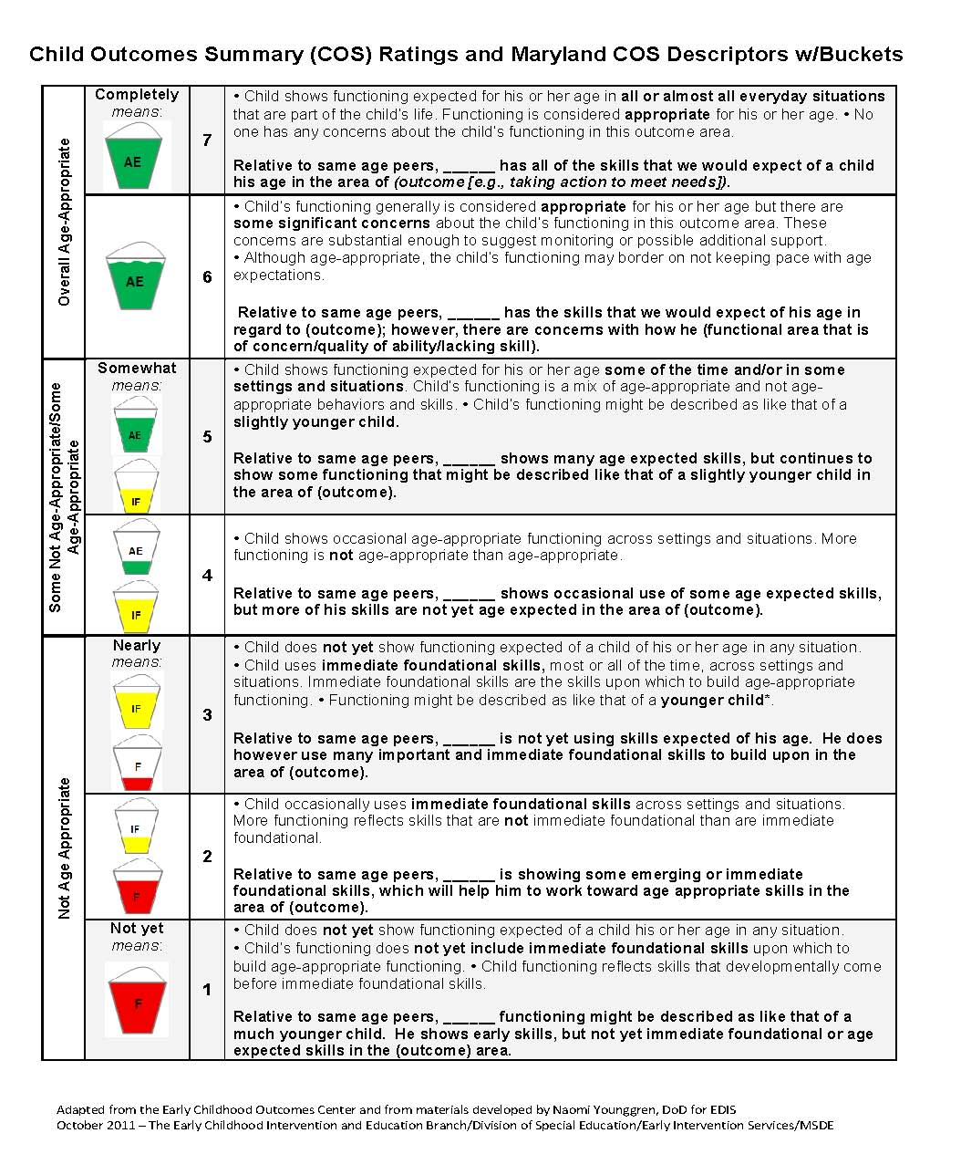
The 7-Point COS Rating Scale:
Maryland’s COS Descriptors with Buckets
Visual depiction of the 7-point COS Rating Scale with family friendly descriptor statements
Aligns with the child outcomes measurement process utilized in the Maryland Infants and Toddlers Program (MITP)
Maryland State Department of Education - Division of Special Education/Early Intervention Services
Notes:
This is a visual depiction of the 7-point COS Rating Scale that includes buckets to assist with visualizing amounts of age appropriate vs. not age appropriate skills. This resource uses family friendly descriptor statements for each of the 7 points on the COS rating scale. The Maryland Infants and Toddlers Program has been implementing the COS process utilizing the family friendly descriptor statements documented on the Individualized Family Service Plan (IFSP) for each of the three early childhood outcomes at entry and exit since 2011. The Maryland Preschool Special Education Program will also use these family-friendly descriptor statements as a part of the Individualized Education Program (IEP) process.

Slide 21
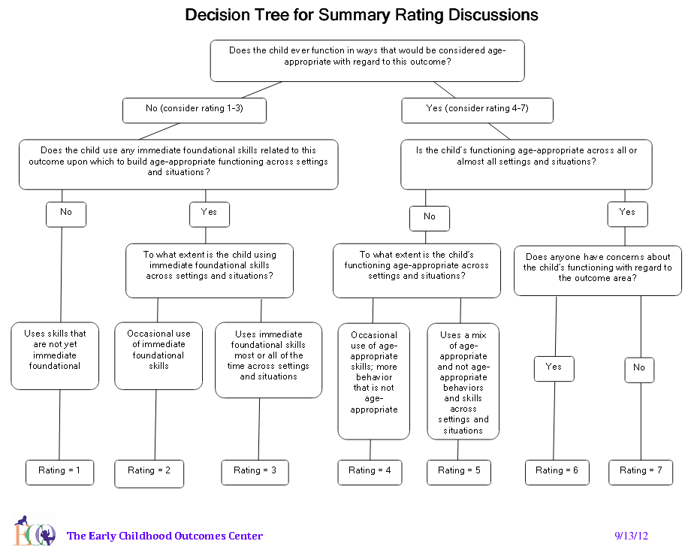
The
7-Point COS Rating Scale:
Decision Tree
Notes:
A helpful resource for guiding the COS rating discussion is the Decision Tree created by the ECO Center. The decision tree is a series of questions about the extent to which a child shows age-established skills and behaviors in each outcome area. The ECO center developed two versions, one with numbers and one without. Teams may find the version without numbers helpful when they are talking with families about their child’s functioning.

Slide 22
Summary Ratings are Based On…
Multiple Methods
Multiple Sources of Information
Curriculum-based assessments
Norm-referenced assessments
Developmental screenings
Formative assessment (e.g., Maryland’s Early Learning Assessment)
Observation, interview, and report
Family information
General and specialized educators
Related service providers
Physicians
Early care and education providers
People familiar with the child in all settings and situations
Maryland State Department of Education - Division of Special Education/Early Intervention Services
Notes:
Remember from the Session 2 presentation that teams will use information from multiple sources, meaning those individuals who best know the child, to determine a rating. Types of information might include curriculum-based and norm-referenced assessment tools, Maryland’s formative assessment (the Early Learning Assessment), observations, family interviews, and developmental screenings from data sources such as family members, therapists, providers, and teachers.

Slide 23

Translating Assessment Scores to Outcomes
A domain score on an assessment tool does not necessarily translate directly into an outcome rating
Ratings require:
  Looking at functional behaviors
  Collecting and synthesizing input from many sources familiar with the child in many different settings and situations
Maryland State Department of Education - Division of Special Education/Early Intervention Services
Notes:
The team should keep in mind that information from assessments will not translate directly to a rating, so teams will need to work together to look at the child’s current functioning and whether or not it is age-appropriate.

Slide 24
Summary Ratings Reflect Global Functioning
Ratings on each outcome are a snapshot of:
  The whole child
  Status of the child’s current functioning
  Functioning across settings and situations
Rather than:
  Skill by skill
  In one standardized way
  Split by domains
Maryland State Department of Education - Division of Special Education/Early Intervention Services
Notes:
This also means that the ratings in each outcome area will reflect the child’s global functioning at one point in time, rather than the child’s specific skills in a given developmental domain.

Slide 25

Deciding the Rating
Focus on the child’s overall functioning across settings and situations
Functioning that is displayed rarely and/or when the child is provided with a lot of unusual support or prompts is of little significance for the rating
Maryland State Department of Education - Division of Special Education/Early Intervention Services
Notes:
When deciding on the rating, focus on the child’s overall functioning across settings and situations. Functioning that is displayed rarely and/or when the child is provided with a lot of unusual support or prompts is of little significance for the rating. Remember that the team will make a decision together about the child’s functioning, and will need to document their rating.

Slide 26
Why is it Important to Document Ratings?
Documentation provides a record of the rationale for the rating decision
  Evidence can be reviewed to see whether people are using the rating scale properly (i.e., rating similar children in the same ways)
  Helps identify needs for future training and technical assistance
  May be useful for new team members reviewing the file
Documentation informs and supports the development of individualized IFSP outcomes and IEP goals
Maryland State Department of Education - Division of Special Education/Early Intervention Services
Notes:
It’s very important to document ratings for two reasons:
First, documentation provides a record of the team’s rationale for the rating. Team members might rate a child’s functioning at a level 5, which is a rating that means the child’s functioning is a mix of age appropriate and not age appropriate. Examples of the child’s age-appropriate skills and behaviors, and examples of his functioning that are not age appropriate to support the rating will help to know that the team used the rating scale properly. When teams are not able to provide evidence to support a rating, or provide evidence that does not clearly support the rating, this might indicate the need for more training and technical assistance around the COS process. This evidence can also help new team members learn about the COS process and the child’s ratings. We document ratings to ensure the quality and accuracy of the COS process.
Documentation is also valuable for teams that use assessment data to support the child’s progress and results. The team, for example, may use the ratings to support the development of individualized IFSP outcomes and IEP goals.

Slide 27


Child Progress Question
For each outcome, it is necessary to answer the child progress question:
Answer only if the COS process was completed for the child at entry
Compare the child’s current and past behavior
Has the child shown any new skills or behaviors in the outcome area since the entry rating (Yes or No)
Small steps of progress count!
Most of the time, the team will select “yes”
Maryland State Department of Education - Division of Special Education/Early Intervention Services
Notes:
After the team arrives at a rating, teams can look at whether the child has shown any new skills or behaviors related to [this outcome] since the last outcomes summary rating. Teams will only answer this question if the COS process was completed for the child at entry or at the annual IEP. Teams will compare the child’s current behavior with past behavior, and discuss whether the child has shown any new skills or behaviors in the outcome area since beginning the program. For example, if the child enters the program completely unable to feed himself but, at exit, can finger feed some foods, that counts as progress. You would answer ‘yes’ to this question, and briefly describe the feeding skills he has acquired. This ongoing progress monitoring provides teams with an opportunity to recognize the child’s incremental progress.

Slide 28


Questions?
Nancy Vorobey
Section Chief, Prevention Initiatives and Early Childhood
410-767-0234
nancy.vorobey@maryland.gov
Pam Miller
Quality Assurance Specialist
410-767-1019
pamela.miller@maryland.gov
Notes:
We have reached the conclusion of this presentation. We thank you for taking the time to complete the Session 3 presentation, "An Overview of the Child Outcomes Summary Rating Process". Should you have questions about the Maryland Preschool Child Outcomes Summary (COS) Process, please contact the individuals listed here.

