Slide 1


BE UNITED in the ZONE
Learning, Family Engagement, Data-Informed Decision Making
BUZ zzz
BUZzzz Summer Institute
Fundamentals
Day 2
Session 3
TBCI Protocol:
Challenge Questions
Powered by Boundless Learning©
Notes:
NOTEBOOK: CQ

Slide 2

SET-Up
S
Take the Challenge!
Sit and organize materials.
E
Review and think about Challenge Question:
T
Examine and follow directions:
Take a seat with your team.
How does the Challenge Question impact TBCI planning?
All team members: Jot down the TBCI stages on your Post-it.
Facilitator: Ask team members to compare answers from their Post-its.
All team members: Be prepared to share.
DATE___
READY TO LEARN TIME:
Powered by Boundless Learning©
Notes:
NOTEBOOK: CQ
Notes: Review Color-Coded Post-its Formative Assessment strategy.
Preparation:
Arrange room for High Performance Learning Teams.
Have students sit within their HP Learning Teams.
DIRECTIONS:
Complete SET-Up tasks.
Also, review and think about the Challenge Question: How does the Challenge Question impact TBCI planning?
Recommended time for this activity is: 5-7 minutes

Slide 3
BE UNITED in the ZONE
Learning, Family Engagement, Data-Informed Decision Making
BUZ z z z
Objective
Participants will:
Design effective Challenge Questions that guide
the development of the TBCI lesson.
Powered by Boundless Learning©
Notes:
NOTEBOOK: CQ
The objective of this session is to design effective Challenge Questions that guide the development of the TBCI lesson.

Slide 4

BUZzzz
BUZ z z z
PRESENTATION
Effective
Challenge Questions
Powered by Boundless Learning©
Notes:
NOTEBOOK: CQ

Slide 5
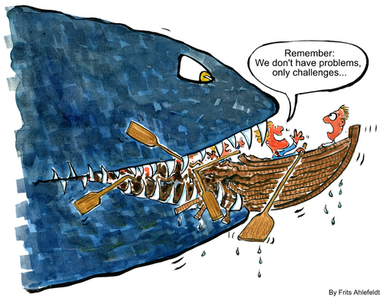
Are Challenges Better Than Problems?
www.toonpool.com
Notes:
NOTEBOOK: CQ
Open the presentation reading the cartoon and let participants know that the challenges we will be facing will have a much better end than the 2 gentlemen in the boat.

Slide 6
BE UNITED in the ZONE
Learning, Family Engagement, Data-Informed Decision Making
BUZ z z z
Inside Outside Circle
Question # 1
  How do you typically introduce the lesson objective to students?
Question # 2
  Do you find it difficult to give students feedback within a given lesson?
Question # 3
  Do you provide students opportunities to engage in self assessment during each lesson?
Powered by Boundless Learning©
Notes:
NOTEBOOK: CQ
Now, we are going to use the structure Inside Outside Circle as a way of activating prior knowledge for this session and reflecting on your current practices relative to how you address providing opportunities for assessments and feedback.
Notes: Remember to give recognition to the learning community for using HP Teaming Principles, maintaining Learning Community Standards, and completing the tasks by coloring in the HP-Hive when appropriate.
ACTIVITY:
Inside Outside Circle
DIRECTIONS:
Have the group form 2 circles by first making one large circle, then having every other person take 2 steps inward.
Direct them to turn around and face the other group of participants and line up in front of one person to form two concentric circles.
Pose the first question: How do you typically introduce the lesson objective to students? (Provide time for participants to share.)
Have the Inside Circle turn to the right, walk past 2 people and stop at the third person for a new partner.
Ask Question # 2: Do you find it difficult to give students feedback within a given lesson? (Provide time for teachers to share.)
Have the Inside Circle turn to the right, walk past 2 people and stop at the third person for a new partner.
Ask for Question # 3: Do you provide students opportunities to engage in self- assessment during each lesson? (Provide time for teachers to share.)
Ask the participants to return to their seats, but keep the discussions we’ve had in mind.
Summarize the discussion and stress the importance of the Challenge Question and how it connects to all aspects of the TBCI lesson. Have participants think about their current formative assessment practices as we address this topic during this session.
Recommended time for this activity is: 10 minutes

Slide 7
Effective Challenge Questions
Are based on standards
  Incremental objectives
Provide a roadmap with the end in mind
  Drive assessment decisions
Are written in student friendly language
  Posed as question
Are answerable by the end of a period of instruction
  One lesson
Emphasize what students will be learning, not doing
  Focused on knowledge not activities
Powered by Boundless Learning©
Notes:
NOTEBOOK: CQ – Resource
An effective Challenge Question is a formative assessment technique that has the following several characteristics:
Based on content standards
May be incremental and scaffolded objectives – the overarching standard as the ultimate goal can also be shared with students. However, the Challenge Question should represent the incremental objectives along the way that will lead to mastery of the standard. Many states have identified Essential Questions which typically are broader in scope than daily Challenge Questions. Consequently, Challenge Questions guide instruction to lead to the answer of the Essential Question.
Provide a roadmap with the end in mind
Drive assessment decisions within the TBCI
Are written in student friendly language
Posed as an answerable question
Are answerable by the end of a period of instruction
One lesson
Guides the placement of embedded formative assessments
Within the TBCI
Emphasizes what students will be learning, not doing
Focused on the knowledge not the activities

Slide 8
Sample Challenge Questions
3.OA.B.5-6
DOMAIN - Operations and Algebraic Thinking (3.OA)
CLUSTER - Understand properties of multiplication and the relationship between multiplication and division.
What is an efficient method for finding quotients?
How can properties of operations help you to find a product or a quotient?
What is an efficient method for finding products?
Notes:
NOTEBOOK: CQ
To create quality Challenge Questions, write with the end in mind. Listed here is the Domain and the Cluster. Look at the individual standards that make up this cluster and ask questions using those as guidelines. Basically, identify what you want students to know at the end of the lesson.

Slide 9
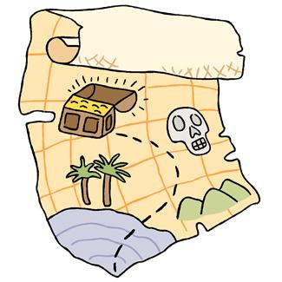

Challenge Questions
If students are starting to veer off course how will you know?
How will you get students back on track?
Challenge Question: START HERE!
Notes:
NOTEBOOK: CQ
Why is the Challenge Question important? The Challenge Question is vital to TBCI planning because it ensures that teachers know where the lesson is headed. In other words, at the end of the instructional cycle, how will teachers know if students have learned what was intended? Using the analogy of a map, how will teachers ensure that all students get to the buried treasure by the end of the lesson? The Challenge Question anchors the lesson from beginning to end ensuring alignment of activities and assessments throughout. Make sure that as students are on their journey within the TBCI, to check-in and keep them on the right path. If students are starting to veer off course, how will you know, and how will you get them back on track so that they are successful in their journey?

Slide 10
Protocols for Instruction: Presentation
P
HPT
Presentation (10-15 minutes)
Seed the Challenge Question
Pique Interest
Activate Prior Knowledge
React
Kick-It with Technology
SPARK
Notes:
NOTEBOOK: CQ
The Challenge Question actually initiates the Presentation stage of the TBCI. Remember, the purpose of the Presentation stage is to stimulate students’ interest in gaining new understandings of the content to answer the Challenge Question successfully. Throughout this stage, teachers actuate SPARK (Seed the Challenge Question /Pique Interest/Activate Prior Knowledge/React/ and Kick-it with Technology). They use a variety of questioning techniques, simple cooperative learning methods, Every Pupil Response (EPR) and technology tools to engage students as the Challenge Question is “seeded” within the new concepts and information is presented. With SPARK, teachers plan presentations that address the Challenge Question and connect to students’ knowledge and interests, creating succinct presentations that stimulate participation by structuring responses and discussions.

Slide 11

Effective Challenge Question Considerations
Challenge Questions drive the design and
implementation of your lesson!
Considerations
Connects to prior learning
Integrates standards and objectives
Promotes higher order level thinking skills
Stimulates complex answers
Provides opportunities for assessing student understanding through a variety of methods
Notes:
NOTEBOOK: CQ - Resource
Let’s look specifically at several key considerations for creating high quality Challenge Questions:
Connects to prior learning - The Challenge Question should activate prior knowledge and ignite thinking about the current objective.
Integrates standards and objectives – The Challenge Question is based on the lesson content.
Promotes higher order level thinking skills – The Challenge Question piques students’ curiosity and requires students to think critically and creatively to address complex problems.
Stimulates complex answers – The Challenge Question encourages students to investigate different approaches and reconsider different aspects to the topic.
Provides opportunities for assessing student understanding through a variety of methods – A quality Challenge Question should be on the developmental level of your students and assessed daily.

Slide 12
Stages of TBCI: Map the Way
If students are starting to veer off course how will you know?
How will you get students back on track?
Elicit Evidence of Learning
Thumbs up, down
Response cards
Adjust Instruction
Reteach
Alternative approach
Provide Feedback
Engage students cognitively
Provide time to act on feedback
Additional practice
Notes:
NOTEBOOK: CQ
Returning to the map analogy, teachers elicit evidence through simple, formative assessments to find out if students are staying the course throughout the lesson. Some ways to do this include Thumbs up/down or Every Pupil Response (EPR) cards. Remember instruction is based on evidence of student performance. Consequently, teachers may reteach using an alternative approach to instruction or provide additional opportunities for practice. Be sure to provide continuous feedback based on performance data to as many students as possible during a lesson. Quality feedback engages students cognitively. It should tell students not just what to do, but how to go about it (Five Key Strategies for Formative Assessment, NCTM, 2007). These actions will ensure that students stay on track and can answer the Challenge Question by the end of the lesson.

Slide 13

BUZzzz
STRUCTURED COOPERATIVE LEARNING
BUZ z z z
LEARNING TOGETHER
Effective
Challenge Questions
Powered by Boundless Learning©
Notes:
NOTEBOOK: CQ
As a Learning Community, we have moved through two stages of the Team Based Cycle of Instruction (TBCI): Set-Up and Presentation. Now, we are ready to engage in the Learning Together stage as partners.

Slide 14

LEARNING GOAL: To determine characteristics of effective Challenge Questions
Learning Together GUIDE
Topic: Effective Challenge Questions
H O T
Challenge Question:
How does the Challenge Question impact TBCI planning?
GENERAL PROCEDURES
Review the Learning Goal and Challenge Question.
Review the Learning Task(s).
Review contents of Learning Together Guide and BDA.
Follow specific directions.
Execute roles and tasks.
Collaborate to assess your team performance.
Circle the H-O-T rating in upper left corner.
Name:
Date:
HP Learning Team Name:
Subject:
Powered by
Boundless Learning ©
TIME:
Notes:
NOTEBOOK: CQ - Resources
During this activity, you will use the Learning Together Guide as you complete the Effective Challenge Questions Activity within your team.

Slide 15


LEARNING GOAL: To determine characteristics of effective Challenge Questions
INITIALS | LEARNING TASKS for Effective Challenge Questions
 | All Team Members: Find the Challenge Question activity in the BUZzzz book. Review directions in the Challenge Question activity.
 | 2. Facilitator States the directions and asks team members if anyone has any questions. Have teammates review highlighted actions within the BDA on the following page. Lead implementation of the Effective Challenge Questions activity. Make sure team is prepared to share responses with the Learning Community.
 | 3. Coach Remind team members - No Free Riders - and maintain the Learning Community Standards.
 | 4. Recorder Record team responses on the Effective Challenge Questions form for team to share with the Learning Community.
 | 5. Supply Manager Make sure team members have the activity and a pencil or pen.
 | 6. Data Manager Share how much time the team will have to complete the activity.
Time for Activity:
Notes:
NOTEBOOK: CQ – Resources

Slide 16
Learning Together: BDA
BEFORE: Purpose
DURING: Purpose
AFTER: Purpose
Make sure team members:
Make sure team members:
Determine if team members:
Know the Learning Goal and Learning Tasks
Have the supplies to complete the activity
Know the Learning Community Standards
Know the HP Teaming Principles
Understand the time allotment for the activity
Understand the task(s), Learning Community Standards, HP Teaming Principles
Completed tasks with high quality
Need extra help during “Just For Me”
Maintained Learning Community Standards
Addressed the HP Teaming Principle(s)
Determine which team members need help
Record team information as directed
Provide time check
Record responses for team tasks
Return supplies and organize materials
Select H-O-T Performance Rating
Powered by
Boundless Learning ©
Notes:
NOTEBOOK: CQ – Resources

Slide 17
Effective Challenge Questions
ACTIVITY
Challenge Questions | H Highly Effective | O Effective | T Not Effective | What would you change to make it highly effective?
Why do we need to have an “order of operations?” | X
What are the four basic operations of mathematics? |  |  | X | …. and give examples of where you would use each one.
Notes:
NOTEBOOK: CQ
Introduce the activity and review the directions with the participants.
ACTIVITY:
Effective Challenge Questions
DIRECTIONS:
All team members review the Learning Together Guide: Challenge Question, General Procedures, Learning Tasks, and BDA.
Follow directions on Effective Challenge Questions activity form.
Work with team members to discuss and determine if questions are highly effective, effective, or not effective. If the question is not highly effective, discuss ways to improve it.
Recommended time for this activity is: 20 minutes

Slide 18
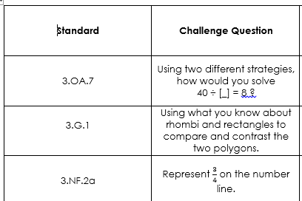
Effective Challenge Questions
ACTIVITY
Notes:
NOTEBOOK: CQ - Resource

Slide 19
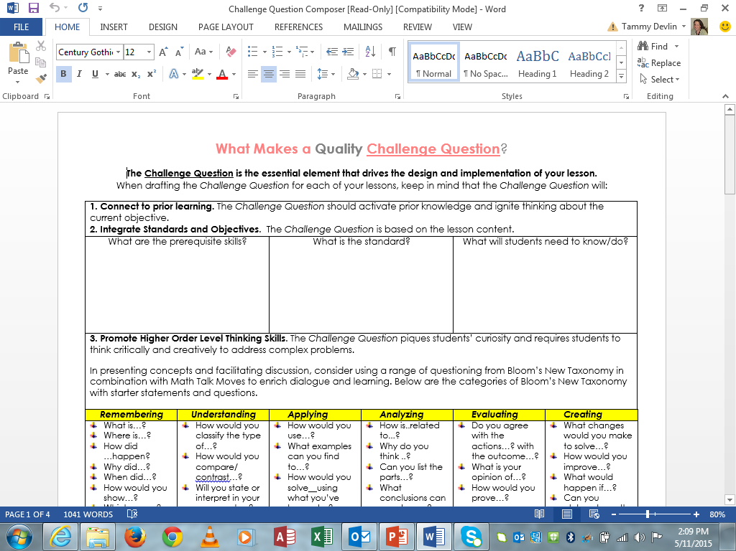

BUZzzz
STRUCTURED COOPERATIVE LEARNING
JUST FOR ME
BUZ z z z
Powered by Boundless Learning©
Notes:
NOTEBOOK: CQ & Resources (The CQ Builder document is in the Resources section)
Using the builder, create a CQ from the 3rd grade standards.

Slide 20

Challenge Question
ACTIVITY
Write a sample Challenge Question.
Second: 2.OA.4 – Use addition to find the total number of objects arranged in rectangular arrays with up to 5 rows and up to 5 columns; write an equation to express the total as a sum of equal addends.
CHALLENGE QUESTION:
Construct a model and explain how you would determine
the total number of objects in an array.
Third: 3.OA.1 – Interpret products of whole numbers, e.g., interpret 5 x 7 as the total number of objects in 5 groups of 7 objects each. For example, describe a context in which a total number of objects can be expressed as 5 x 7.
CHALLENGE QUESTION???
Notes:
NOTEBOOK: CQ (Sample CQ Builder & 3rd Grade CQ Builder in session resources)
ACTIVITY:
Challenge Question Builder
DIRECTIONS:
Review the components of the Challenge Questions Builder.
Ask teammates for clarification if needed.
Use the 3rd grade domain/cluster from the Maryland College and Career Ready Standards in Mathematics listed above.
Follow the steps in the builder to create a highly effective Challenge Question.
Recommended time for this activity is 10 minutes.
*If time allows, have participants switch papers and assess the Challenge Question using the H-O-T Scoring.

Slide 21

BUZzzz
STRUCTURED COOPERATIVE LEARNING
BUZ z z z
ASSESSMENT
Answer the Challenge Question
Powered by Boundless Learning©
Notes:
NOTEBOOK: CQ

Slide 22
Team Challenge Check
How does the Challenge Question
impact TBCI planning?
Success Criteria
The CQ response should include:
Reference to the stages of the TBCI
Reference to the concepts discussed in this presentation
Reference to the Effective Challenge Question Considerations
Notes:
NOTEBOOK: CQ - Resources
As a team, think about the response to today’s Challenge Question. Write a team response on the Team Challenge Check. Make sure everyone in the team participates.
ACTIVITY:
Team Challenge Check
DIRECTIONS:
Coach – Lead the activity so that all members contribute to the Challenge Question Check.
Coach – Review success criteria.
Facilitator – Be sure that all members actively engage in developing the Challenge Question response.
Recorder – Enters the response on the Team Challenge Check form.
Data Manager – Share the time for the activity.
Supply Manager – Return the completed Team Challenge Check form to the Team Supply table.
Recommended time for this activity is: 3 minutes

Slide 23
Team Challenge Question Check
Answer the Challenge Question:
How does the Challenge Question impact TBCI planning?
Challenge Question Check
Team name_____________
Date____________
________________________________________________________________________________________________________________________________________________________________________________________________________________________________________________________________________________________________________________________________________________________________________
Powered by
Boundless Learning ©
Notes:
NOTEBOOK: CQ – Resources and Team Book

Slide 24
BE UNITED in the ZONE
Learning, Family Engagement, Data-Informed Decision Making
BUZ z z z
Objectives
Participants will:
Identify the core components of the BUZzzz initiative.
Describe how Family Engagement will be addressed within routine instruction.
Identify Principles of High Performance Teaming.
Describe key practices for building productive learning groups and High Performance Learning Teams.
Use the basic 12-to-Excel Management Strategies.
Describe the Team-Based Cycle of Instruction stages and how UDL is addressed.
Understand how to develop daily Challenge Questions.
Powered by
Boundless Learning ©
Notes:
NOTEBOOK: Getting Started
For the next couple of days, you will be presented with a great deal of information and engaging practices for building highly productive learning environments for virtually all students, particularly those students with special needs. By the end of the Institute, you will be able to:
Identify the core components of the BUZzzz initiative.
Describe how Family Engagement will be addressed within routine instruction.
Identify principles of High Performance Teaming.
Describe key practices for building productive learning groups and High Performance Learning Teams.
Use the basic 12-to-Excel Management Strategies.
Describe the Team-Based Cycle of Instruction stages and how UDL is addressed.
Understand how to develop daily Challenge Questions.
For this BUZzzz Summer Institute, you will participate in a simulation professional learning experience to develop understandings of and skills in practices that you will implement in your classes next year. One of those practices, the Team-Based Cycle of Instruction (TBCI): A UDL Approach, will be used as the instructional delivery system for all learning activities at the Summer Institute. Each day you will engage in several TBCI experiences from the initial to the final stage of instruction. So, let’s take a quick look at what constitutes the TBCI.

Slide 25
WRAP-Up
Date______
W
Prepare to transition.
P
Did I/we complete tasks?
Did I/we maintain Learning Community Standards?
Assess how well you worked in our Learning Community, your partnership, and your HP Learning Team:
A
Return and/or organize supplies.
R
Wonder what Challenge Questions will look like, sound like, and feel like in your Learning Community.
Rate our team performance using H-O-T.
READY TO EXIT TIME
3:30
Powered by Boundless Learning©
Notes:
NOTEBOOK: CQ
DIRECTIONS:
Follow WRAP-Up procedures and prepare to transition.
Provide feedback to the community on their work quality and determine using EPR an H-O-T Rating for the Learning Community.
Recommended time for this activity is: 5 minutes

Slide 26
Learning Community Response
FACILITATOR: Lead a discussion on techniques, strategies, activities, etc. that you’ve used to gain information about students’ current understanding during a lesson.
“It is a way for us to take stock during the learning process and can help inform us of how the learning is progressing”
Assessment for Learning for Key Stages 1 & 2
http://www.nicurriculum.org.uk/docs/assessment_for_learning/training/afl-guidance-ks12.pdf
Write down one example and hold up your index card.
Notes:
NOTEBOOK: CQ – Additional Resource if time permits
Preparation:
Have 5x7 index cards for each participant.
ACTIVITY:
Learning Community Response
DIRECTIONS:
Facilitator: Discuss the kinds of techniques, strategies, or other activities that you have used to gain information about students’ levels of understanding during a lesson.
Supply Manager: Distribute index cards after 5 minutes.
All team members: Write down one example that was discussed.
Hold up index cards when prompted.
The Learning Community Response is an example of a practical, formative assessment within a given lesson. A simple strategy like Learning Community Response helps teachers gauge their next step in instruction. It is important that if a teacher does not see evidence of understanding, he/she should reteach the concepts or skills and then reassess using an appropriate formative assessment.
Now, let’s consider what makes formative assessment effective.

